Slide 1


IMDB MOVIE
ANALYSIS
Ashiq Paul
Trainity

Slide 2


Project Description
This project involves analyzing an IMDB movie dataset to identify the factors influencing the success of movies, measured by their IMDB ratings. The analysis covers various aspects such as movie genres, durations, languages, directors, budgets, and their relationships to ratings and financial success.

Slide 3


Tech-Stack Used
1
2
3
Microsoft Excel
Canva / Powerpoint
Loom

Slide 4

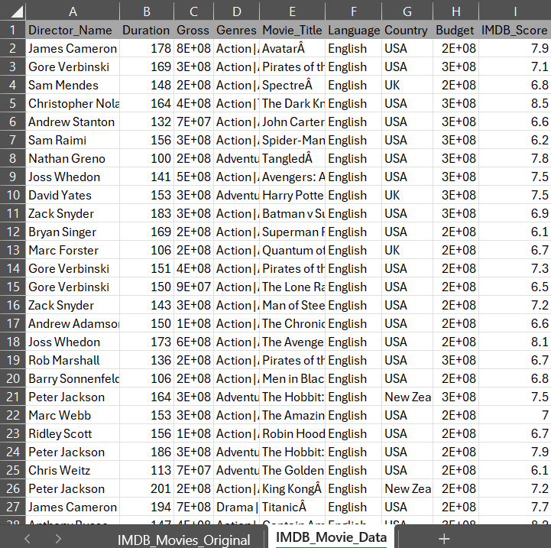
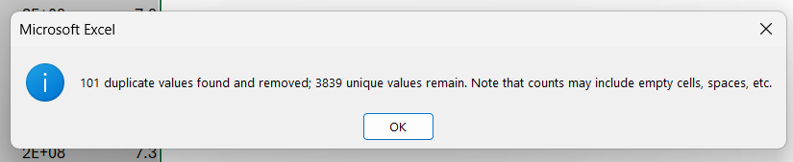
Data Cleaning
There are too many columns and there are some which are not required for this analysis, like the color of the movie, imdb link, facebook likes, etc.
There are blanks present in the dataset, the blanks can either be filled with data from the internet or completely removed. But in this case there are far too many blanks, so we delete the entire rows with blanks.
There are duplicate rows present as well that needs to be removed.
Some values in the Country column has been replaced after verified with Google

Slide 5

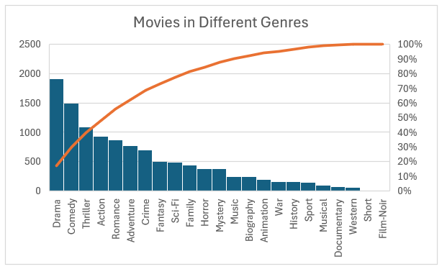
A. Movie Genre Analysis
Analyze the distribution of movie genres and their impact on the IMDB score.
Determine the most common genres of movies in the dataset. Then, for each genre, calculate descriptive statistics (mean, median, mode, range, variance, standard deviation) of the IMDB scores.

Slide 6
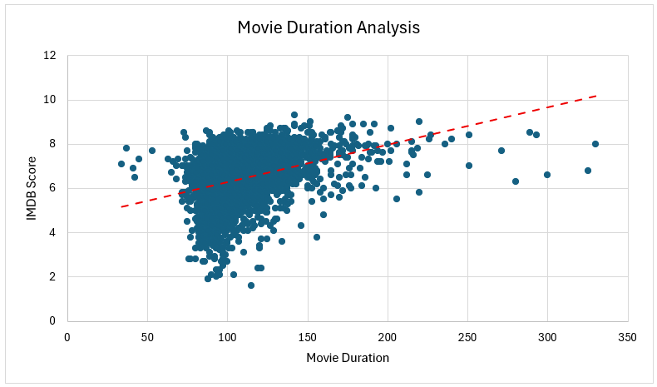
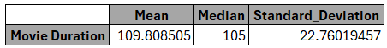
B. Movie Duration Analysis
Analyze the distribution of movie durations and its impact on the IMDB score.
Analyze the distribution of movie durations and identify the relationship between movie duration and IMDB score.

Slide 7
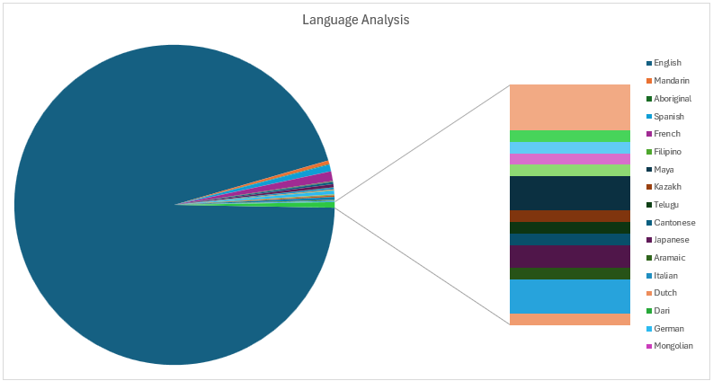
C. Language Analysis
Examine the distribution of movies based on their language.
Determine the most common languages used in movies and analyze their impact on the IMDB score using descriptive statistics.

Slide 8
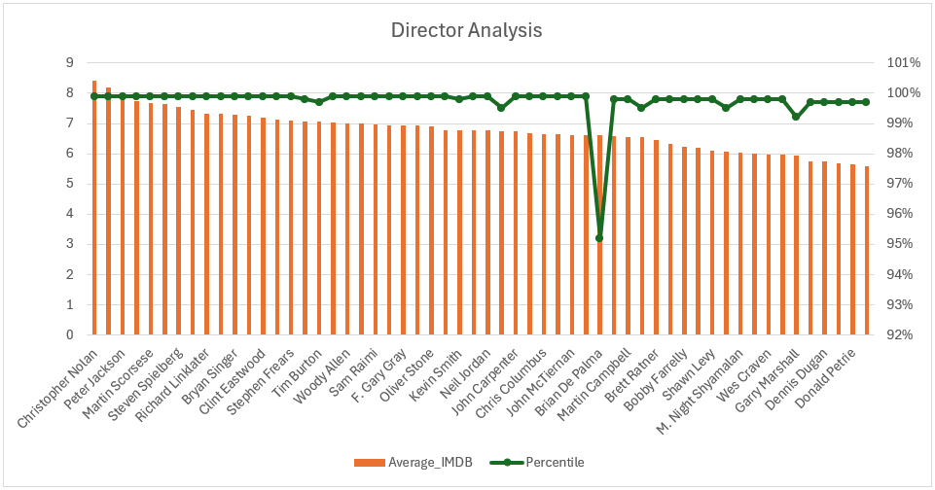
D. Director Analysis
Influence of directors on movie ratings.
Identify the top directors based on their average IMDB score and analyze their contribution to the success of movies using percentile calculations.

Slide 9
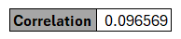
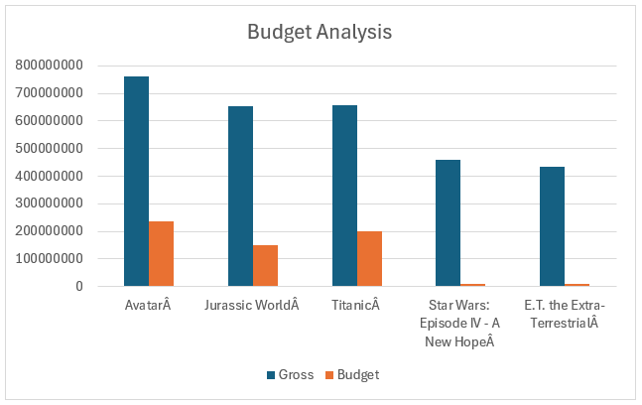
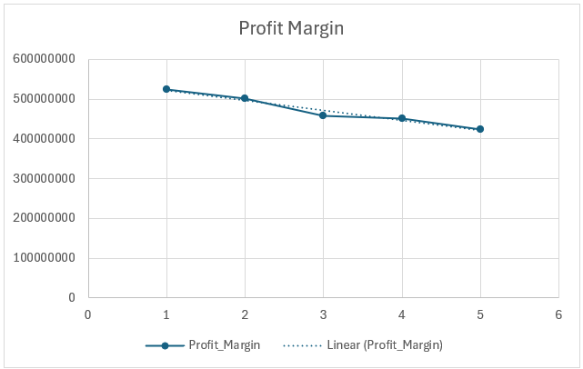
E. Budget Analysis
Explore the relationship between movie budgets and their financial success.
Analyze the correlation between movie budgets and gross earnings, and identify the movies with the highest profit margin.

Slide 10
Result

Slide 11
Thank You
TRAINITY

